Slide 1

What should you know to start building Golang Services for Kubernetes?
Wojciech Barczyński VP of Engineering

Slide 2
Whoami
VP of Engineering at Spacelift.io
Golang Developer - a bit less time for it recently
System Engineer

Slide 3
No free lunch - application way smarter (12factorapps, metrics, coordination …)
https://www.flickr.com/photos/160866001@N07/

Slide 4
App development
12 factor apps
Observability
Liveness and Readiness probe
Working with Kubernetes

Slide 5
12 factor apps
Inject the configuration with the env variables
Log to stdout (structured)
Scale up the app by adding new instance
https://12factor.net

Slide 6
12 factor apps
MTTR versus MTTF, fail fast
Assume every external call might fail – retries and timeouts
https://12factor.net

Slide 7
Expectations
Understanding of the Kubernetes concepts:
Deployment
Service
ConfigMap and Secrets
Observability

Slide 8
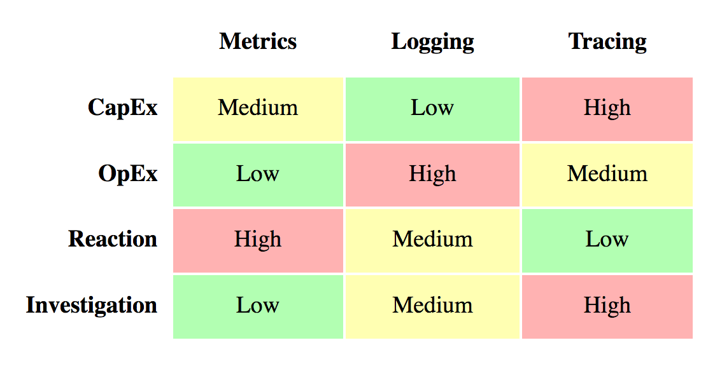
Observability
https://peter.bourgon.org/go-for-industrial-programming/

Slide 9
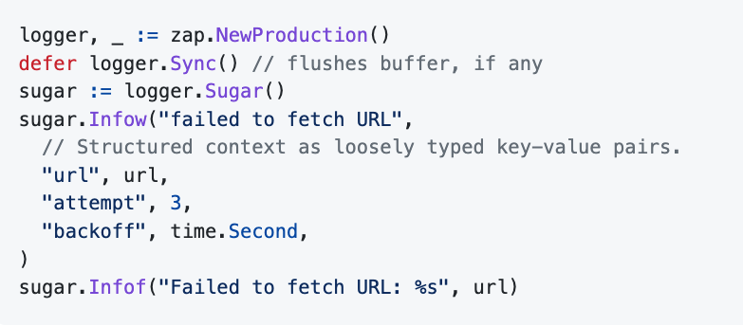
Observability - logging
structured uber-go/zap and logrus

Slide 10
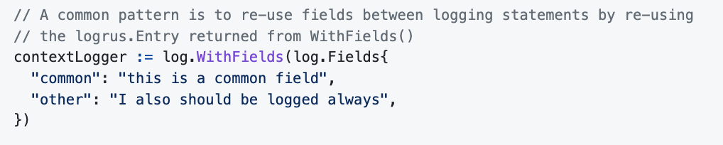
Observability - logging
Pass the logger with Context
Configurable with env variable - LOG_LEVEL

Slide 11
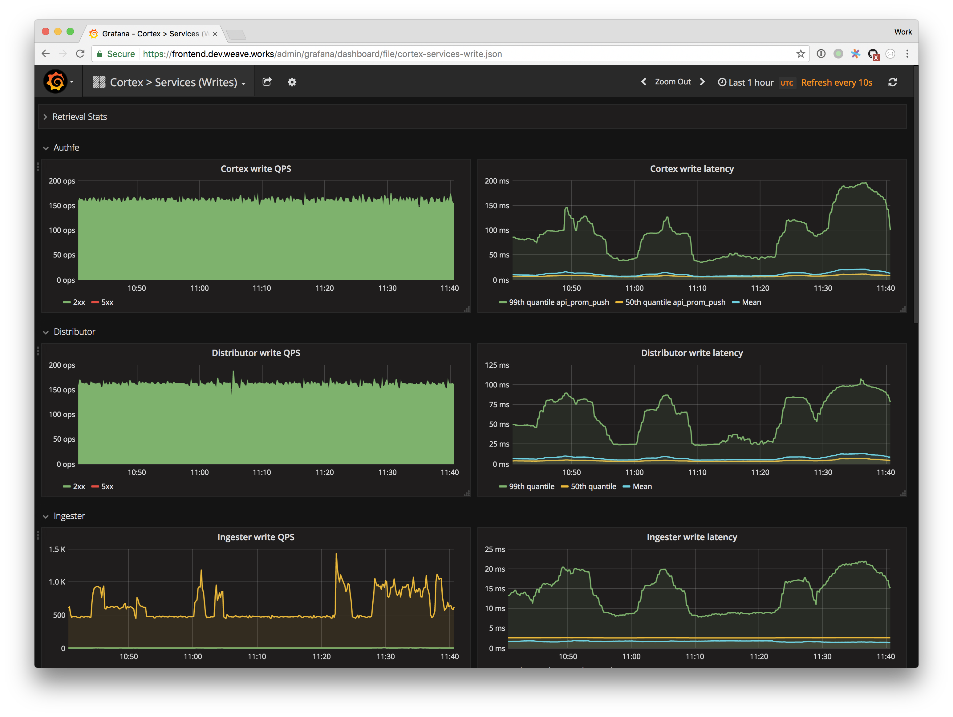

Observability - monitoring
Name | Label | Value
traefik_requests_total | code="200", method="GET" | 3001

Slide 12
Observability - monitoring
Use Prometheus Golang library
Monitor yourself
Monitor your dependencies
Check the best practices - https://prometheus.io/docs/practices/naming/
https://prometheus.io/docs/guides/go-application/

Slide 13
Observability - monitoring
apiVersion: v1
kind: Service
metadata:
name: my-app
annotations:
prometheus.io/scrape: 'true'
prometheus.io/port: '9090'
prometheus.io/path: 'metrics/'
spec:
selector:
app: my-app
ports:
- port: 8080
target_port: 8080
Annotate your service
https://prometheus.io/docs/practices/naming/

Slide 14
Observability - monitoring
RED – Rate Error Duration
USE – Utilization Saturation and Errors

Slide 15
Cooperation with K8S
readinessProbe:
httpGet:
path: /ready
port: 8090
livenessProbe:
httpGet:
path: /healthz
port: 8090
initialDelaySeconds: 5
periodSeconds: 5
Readiness probe
– are you ready to server traffic?
– are my dependencies responding?
Liveness probe
– am I alive?
– did I hanged

Slide 16
Cooperation with K8S
readinessProbe:
httpGet:
path: /ready
port: 8090
livenessProbe:
httpGet:
path: /healthz
port: 8090
initialDelaySeconds: 5
periodSeconds: 5
Readiness probe
– are you ready to server traffic?
– are my dependencies responding?
Liveness probe
– am I alive?
– did I hanged
Start with Liveness.

Slide 17
Cooperation with K8S
When the probe fails:
Readiness probe
– Kubernetes stops (eventually) sending requests
Liveness probe – Kubernetes SIGTERM followed by SIGKILL

Slide 18
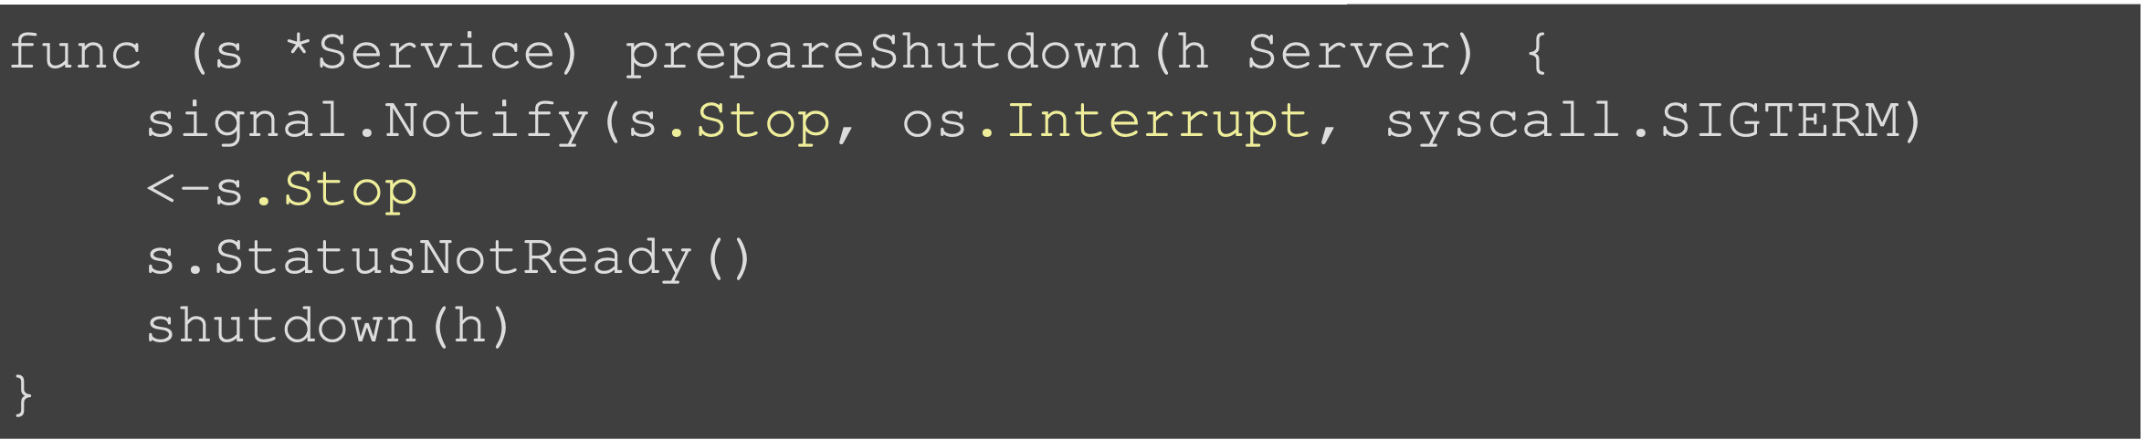
When K8S stops your pod
Kubernetes sends SIGTERM
App should handle it and set the readiness probe to not ready
Kubernetes stops sending requests
App should shutdown gracefully

Slide 19
QoS – why k8s migrated my pod
QoS:
Guaranteed
Burstable
Best Effort

Slide 20
Smoke test & Readiness /Liveness probes
Does my app work?

Slide 21

How to choose the tech?

Slide 22
High performance
Lead Time
Deployment frequency
Mean time to Recovery
Change Fail Percent

Slide 23
High performance
Commercial success
…
Satisfaction of the employees

Slide 24




Our goal
Lead time
Deployment frequency

Slide 25
Kubernetes
Black (Blue) Box
Almost invisible infrastructure
Developer in the driving seat
https://en.wikipedia.org/wiki/File:Dr_Who_(316350537).jpg

Slide 26
Kubernetes
Common language
Artifacts
Platform

Slide 27

The way of Kubernetes
In iterations
Learn-as-you-go
https://www.flickr.com/photos/bruno_brujah/

Slide 28
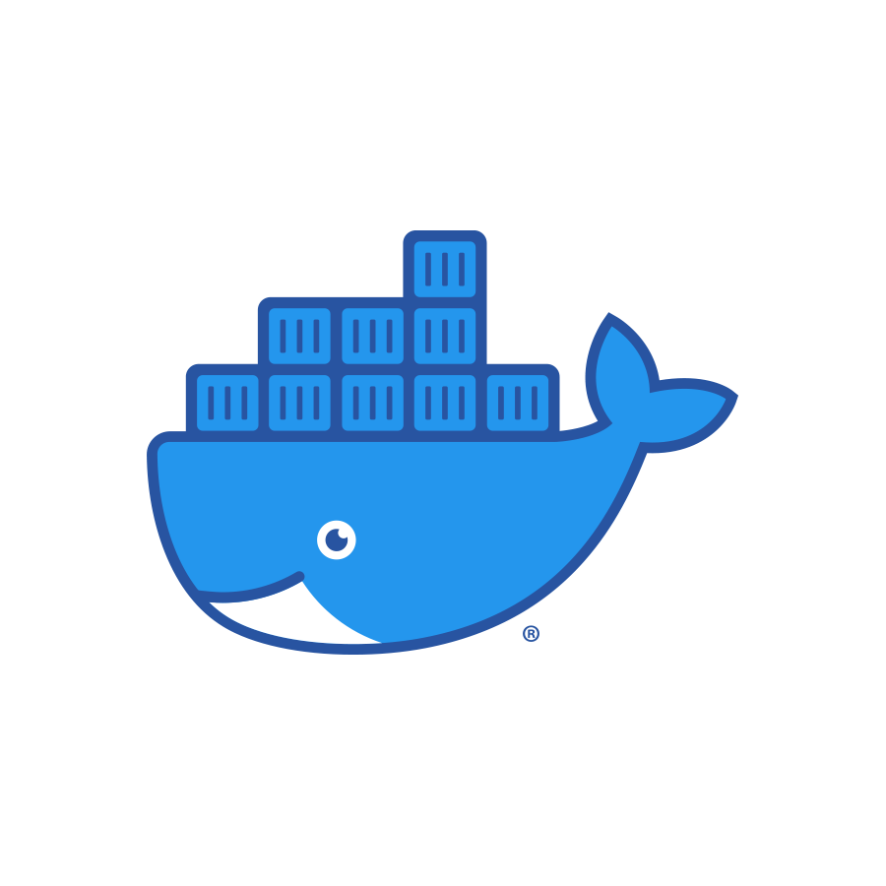
Docker
Use linters, for example, hadolint
Reduce size and numbers of layers: .dockerignore && multi-stage
RUN apt-get -y update \
&& apt-get install –y vim –no-install-recommended \
&& rm –rf /var/lib/apt/lists/*
https://github.com/wojciech12/talk_k8s_what_should_every_dev_know/tree/master/notes_on_learning/02_docker_bestpractises

Slide 29
Docker
3. Do not leave secrets in your Docker
4. Use trivy to scan your Docker images
https://github.com/wojciech12/talk_k8s_what_should_every_dev_know/tree/master/notes_on_learning/02_docker_bestpractises
Notes:
https://github.com/wojciech12/talk_k8s_what_should_every_dev_know/tree/master/notes_on_learning/02_docker_bestpractises

Slide 30
Manifest generation v1
Helm as a templating engine
Apply the manifest with your CI/CD pipeline
Manual secret creation or go with secrets-store-csi-driver.sigs.k8s.io
deployment_v1
├── Chart.yaml
├── templates
│ ├── configmap.yaml
│ ├── deployment.yaml
│ └── service.yaml
├── values.yaml
├── values_dev.yaml
├── values_prod.yaml
└── values_staging.yaml

Slide 31
Manifest generation v1
Keep templating to minimal YAGNI
Generated K8S manifests apply on the Kubernetes cluster
(alternative) use a transitive repo
deployment_v1
├── Chart.yaml
├── templates
│ ├── configmap.yaml
│ ├── deployment.yaml
│ └── service.yaml
├── values.yaml
├── values_dev.yaml
├── values_prod.yaml
└── values_staging.yaml
https://github.com/wojciech12/talk_what_I_would_every_dev_know/tree/master/01_app_deployment#steps-in-learning

Slide 32
Manifest generation v2+
Choose your adventure:
Better secret management
ArgoCD?
Deployment strategies
Dev env on demand
deployment_v1
├── Chart.yaml
├── templates
│ ├── configmap.yaml
│ ├── deployment.yaml
│ └── service.yaml
├── values.yaml
├── values_dev.yaml
├── values_prod.yaml
└── values_staging.yaml
Notes:
https://github.com/wojciech12/talk_what_I_would_every_dev_know/tree/master/01_app_deployment#steps-in-learning

Slide 33


Manifest generation v2+
What is a K8S without infrastructure?
Next - opening Infrastructure-as-a-Code
deployment_v1
├── Chart.yaml
├── templates
│ ├── configmap.yaml
│ ├── deployment.yaml
│ └── service.yaml
├── values.yaml
├── values_dev.yaml
├── values_prod.yaml
└── values_staging.yaml
Kubernetes operators
AWS CDK
Notes:
https://github.com/wojciech12/talk_what_I_would_every_dev_know/tree/master/01_app_deployment#steps-in-learning

Slide 34
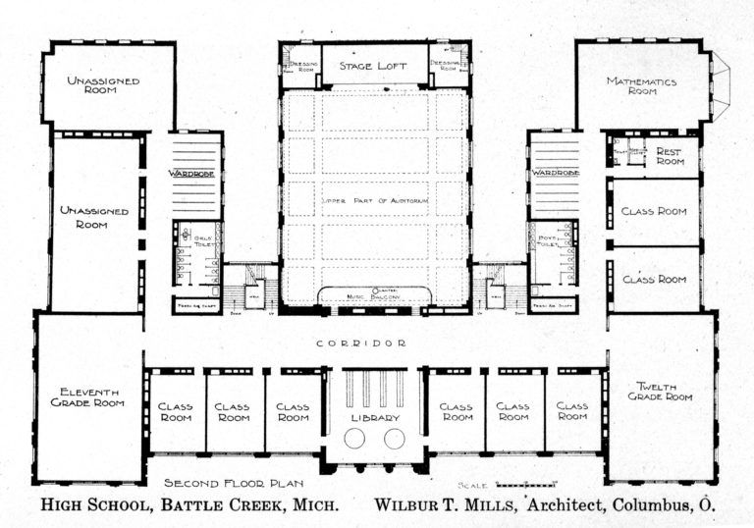
Conventions over tools
New repository:
Generator or copy&paste: Makefile, ci.yaml, Dockerfile, helm, …
Modify few things
Ready & Go

Slide 35
Conventions over tools
New repository:
We want people to change the generated code
We just ask for keeping the common conventions

Slide 36



v1.5
Generation scripts as the interface between the component and the platform
Repository app A
Repository app B
dev
staging
prod
Repository app C
Transitive repo with the current cluster state for every environment.
Common conventions
Notes:
conftest

Slide 37

v1.5
Generation scripts as the interface between the component and the platform
Repository app A
Repository app B
dev
staging
prod
Repository app C
conftest to validate manifests
Common conventions
Notes:
conftest

Slide 38
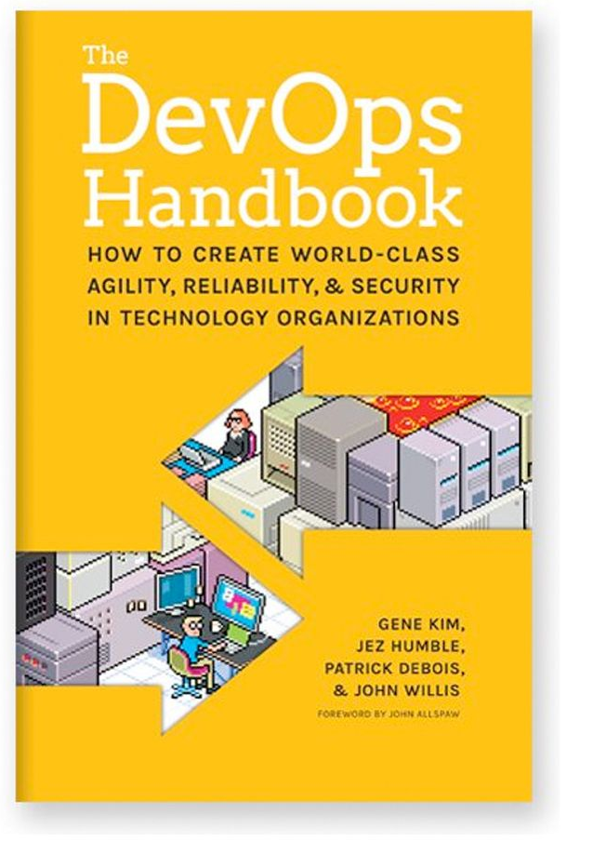

Recommended read
2
The first 4 chapters, the rest if you have time.
3
A story, not as straight forward as (1)
1
Concrete, do A, do B,
because C (DevOps here as culture, not an admin ☺ )

Slide 39
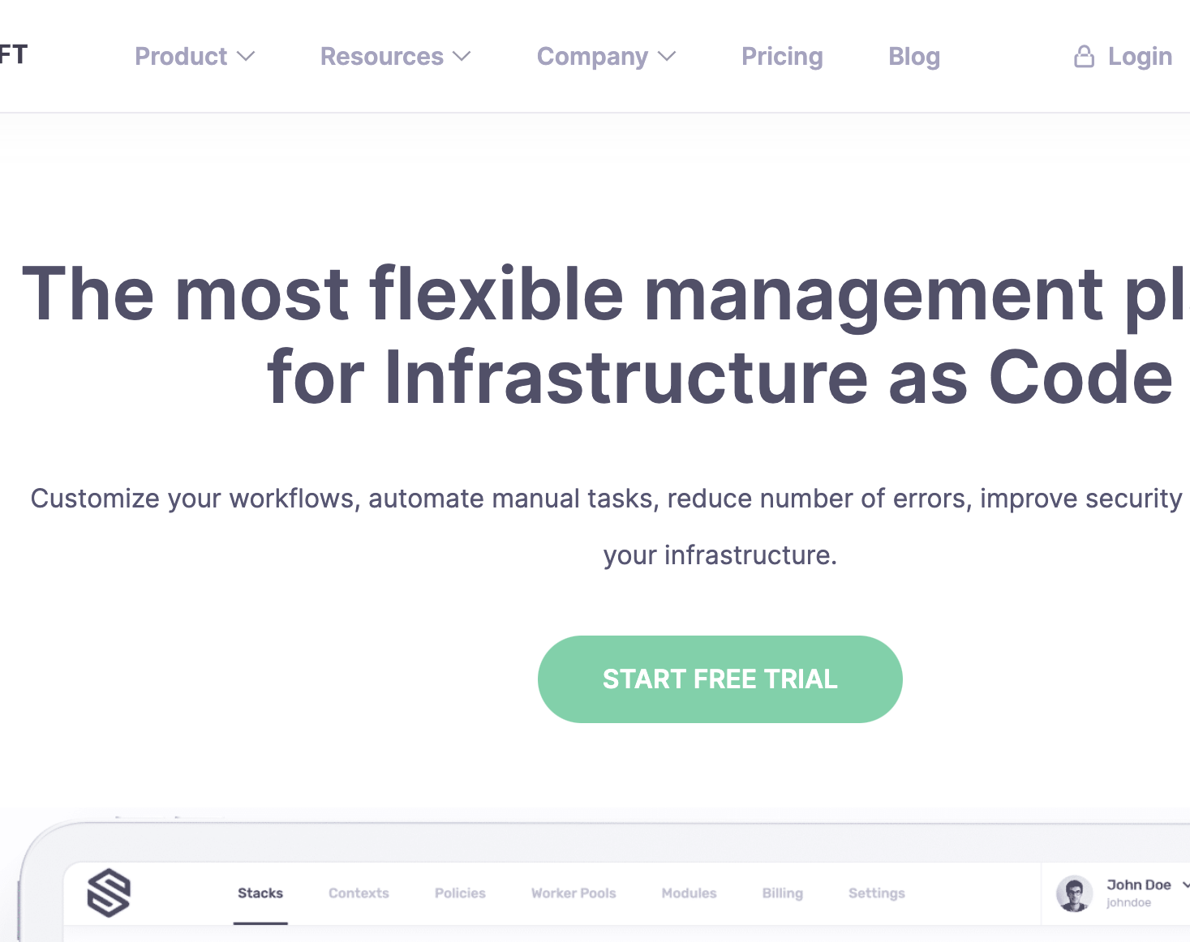

Hiring
Golang* developers passionate about system engineering, DevOps culture, or building tools.
* at least 1 year of experience in Golang.
Learn more/apply: https://grnh.se/9b76ed375us

Slide 40
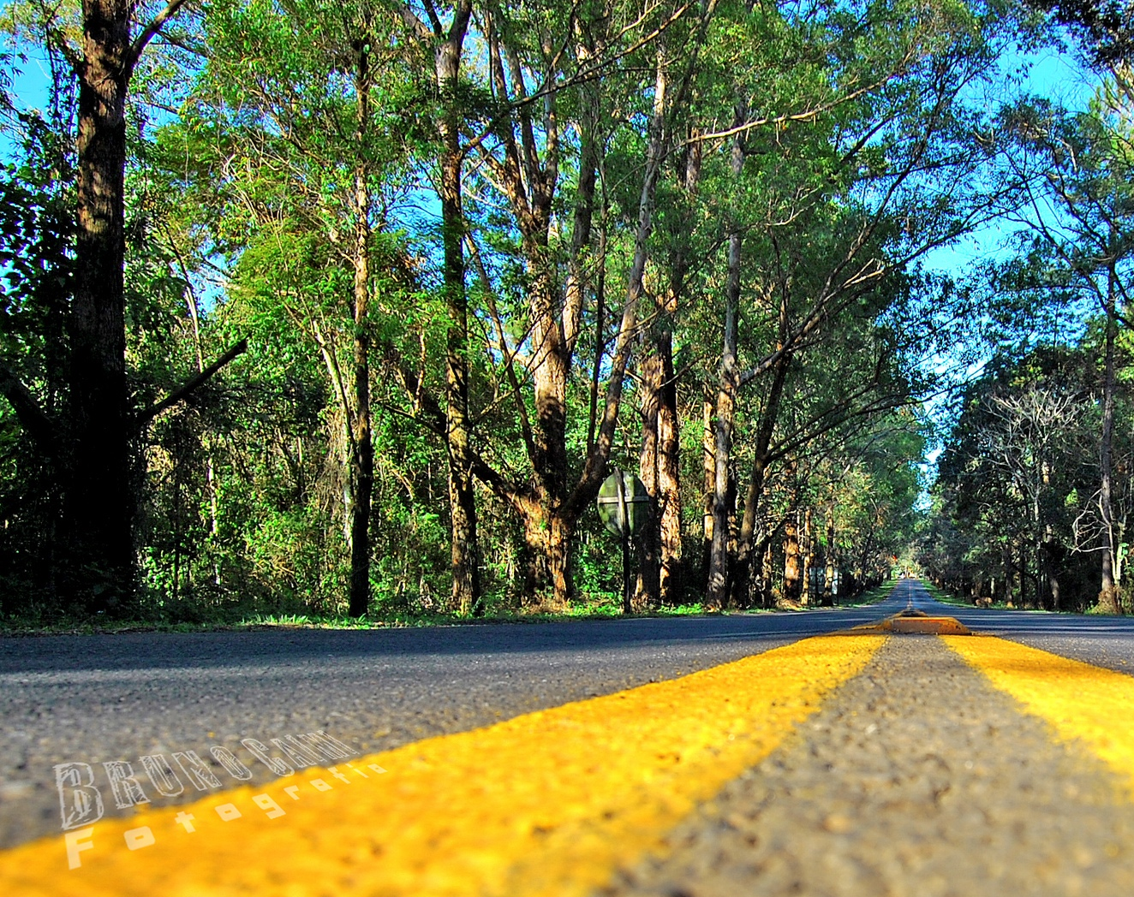
Questions?
https://www.flickr.com/photos/bruno_brujah/

Slide 41
Backup

Slide 42
Developers
Learn basic Kubernetes artifacts and commands
CI/CD should take over
Common conventions over common tools
TBA

Slide 43
Rabbit holes everywhere…
Approach:
The iteration, decision, deliver
As soon as possible to get into the cycle Patch Patch Patch
Alternative take:
Lean v1/v2*
* https://katemats.com/blog/lean-software-development-build-v1s-and-v2s

Slide 44
OODA
https://upload.wikimedia.org/wikipedia/commons/3/3a/OODA.Boyd.svg

Slide 45

Observability

Slide 46




Observability - logging
Zmienna środowiskowa w deploymencie LOG_LEVEL
Logi, najlepiej, JSON
Wiele bibiotek, np., dla Golanga: zap lub logrus

Slide 47
Migracja na Kubernetes / CloudNative
Warto połączyć z projektem biznesowym
Pamiętać o celu:
– częste wydania i krótki cykl dla budowy funkcjonalności
– autonomia zespołów, self-service

Slide 48
Kubernetes
Podejmujemy decyzję jak najwcześniej
Komponent samodzielny
Proces budowy oprogramowania
Continuous Deployment
Jak najwięcej szczegółów aplikacji jest przechowywana w repozytorium gita.

Slide 49
W jaki sposób?
Proces budowy oprogramowania
Continuous Deployment
2
Self-service dev, tester, op pracują w jednym repozytorium gita

